Slide 1
Chapter 9
Resource Allocation

Slide 2
What is Resource Allocation?
Allocating resources (human, technical, etc) to projects
Use in both individual and multiple, simultaneous projects
Relates to scheduling and costs
8-<number>

Slide 3
Critical Path Method—Crashing a Project
Time and costs are interrelated
Faster an activity is completed, more is the cost
Change the schedule and you change the budget
Thus many activities can be speeded up by spending more money
8-<number>

Slide 4
What is Crashing / Crunching?
To speed up, or expedite, a project
Of course, the resources to do this must be available
Crunching a project changes the schedule for all activities
This will have an impact on schedules for all the subcontractors
Crunching a project often introduces unanticipated problems
8-<number>

Slide 5
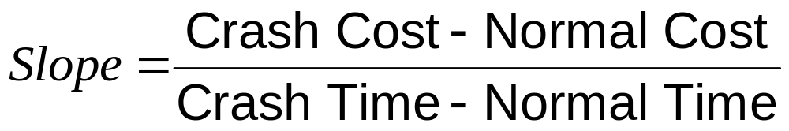
Activity Slope
8-<number>

Slide 6
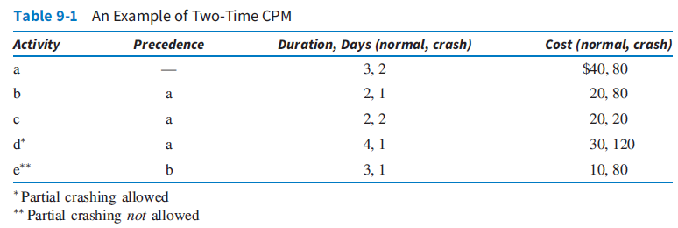
An Example of Two-Time CPM
8-<number>

Slide 7
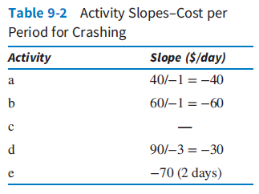
Activity Slopes—Cost per Period for Crashing
8-<number>

Slide 8
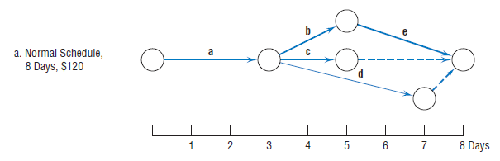
Crashing the Project
8-<number>

Slide 9
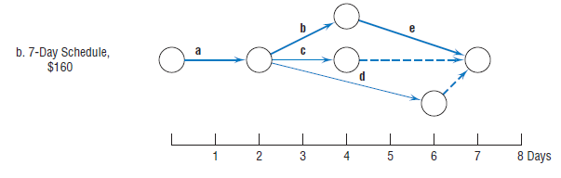
Seven Day Schedule
8-<number>

Slide 10
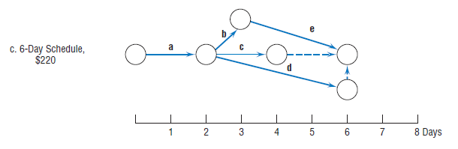
Six Day Schedule
8-<number>

Slide 11
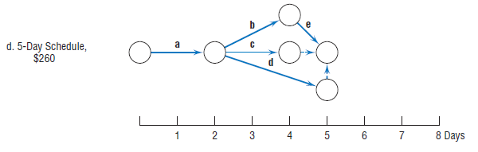
Five Day Schedule
8-<number>

Slide 12
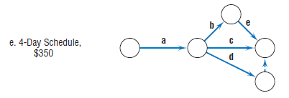
Four Day Schedule
8-<number>

Slide 13
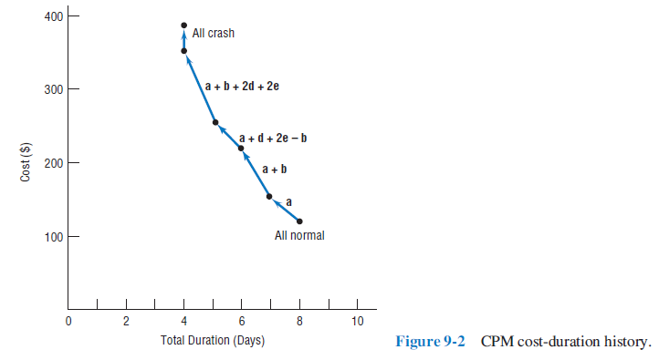
Cost-Crash Curve
8-<number>

Slide 14
Fast-Tracking
Fast-tracking is another way to expedite a project
  Mostly used for construction projects
  Can be used in other projects
Refers to overlapping design and build phases
Increases number of change orders
Increase is not that large
8-<number>

Slide 15
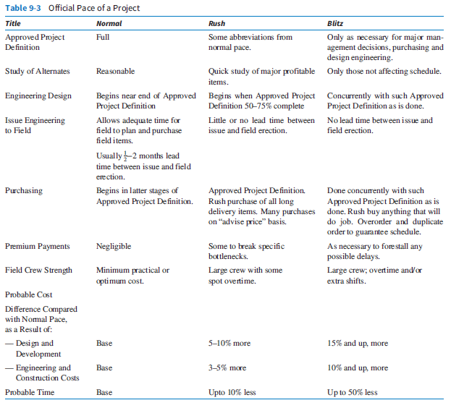
Official Pace of a Project
8-<number>

Slide 16
The Resource Allocation Problem
CPM/PERT ignore resource utilization and availability
With external resources, this may not be a problem
It is, however, a concern with internal resources
Schedules need to be evaluated in terms of both time and resources
8-<number>

Slide 17
Time Use and Resource Use
Time limited: A project must be finished by a certain time
Resource limited: A project must be finished without exceeding some specific level of resource usage
Overdetermined: when time, cost, and scope are fixed
System-constrained: A project requires a fixed amount of time and resources
8-<number>

Slide 18
Resource Loading
Resource loading describes the amount of resources an existing schedule requires
Gives an understanding of the demands a project will make of a firm’s resources
8-<number>

Slide 19
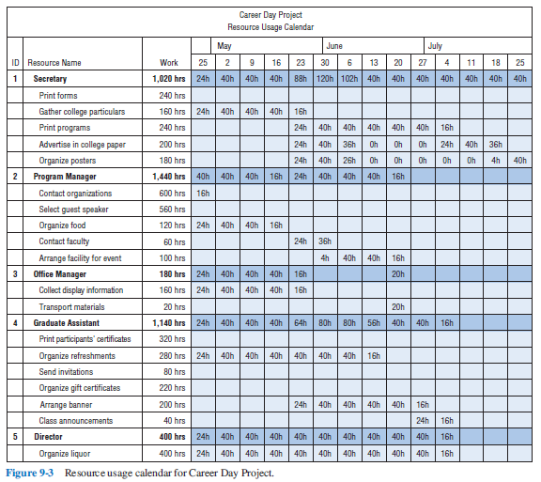
Resource Usage Calendar
8-<number>

Slide 20
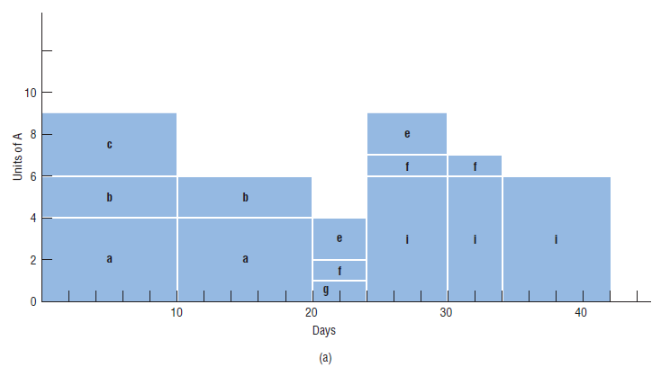
Resource A
8-<number>

Slide 21
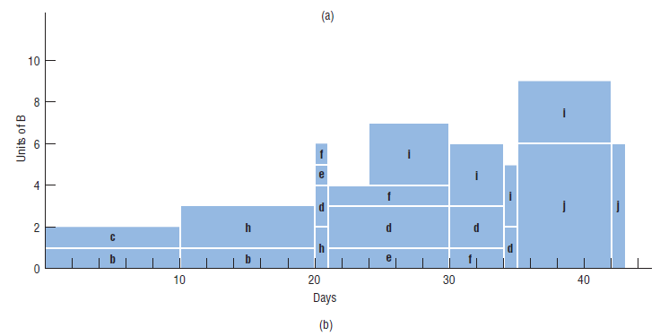
Resource B
8-<number>

Slide 22
Resource Leveling (Slide 1 of 3)
Less hands-on management is required
May be able to use just-in-time inventory
Improves morale
Fewer personnel problems
When an activity has slack, we can move that activity to shift its resource usage
8-<number>

Slide 23
Resource Leveling (Slide 2 of 3)
May also be possible to alter the sequence of activities to levelize resources
Small projects can be levelized by hand
Software can levelize resources for larger projects
Large projects with multiple resources are complex to levelize
8-<number>

Slide 24
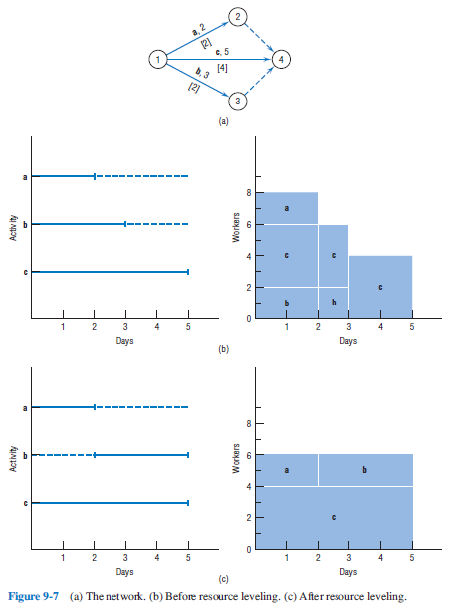
Resource Leveling (Slide 3 of 3)
8-<number>

Slide 25
Resource Loading/Leveling and Uncertainty
Resource availability, needs, etc may fluctuate over time such that resources required and capacity available may not be constant
Methods to address this issue:
  Attempt to level demand
  Alter supply of human resource availability
Disruptions, emergencies, maintenance, personnel issues, inefficiencies
Schedule scarce resources between 85-90% capacity
8-<number>

Slide 26
Constrained Resource Scheduling
Heuristic Approach | An approach, such as a rule of thumb, that yields a good solution that may or may not be optimal
Optimization Approach | An approach, such as linear programming, that yields the one best solution.
8-<number>

Slide 27
Heuristic Methods (Slide 1 of 2)
They are the only feasible methods used to attack large projects
While not optimal, the schedules are very good
Take the CPM/PERT schedule as a baseline
8-<number>

Slide 28
Heuristic Methods (Slide 2 of 2)
They sequentially step through the schedule trying to move resource requirements around to levelize them
Resources are moved around based on one or more priority rules
8-<number>

Slide 29
Common Priority Rules
As soon as possible
As late as possible
Shortest task first
Most resources first
Minimum slack first
Most critical followers
Most successors
Arbitrary
8-<number>

Slide 30
Heuristic Methods
These are just the common ones
There are many more
The heuristic can either start at the beginning and work forwards
Or it can start at the end and work backwards
8-<number>

Slide 31
Optimizing Methods
Finds the one best solution
Uses either linear programming or enumeration
Not all projects can be optimized
8-<number>

Slide 32
Goldratt’s Critical Chain (Slide 1 of 2)
This is the best attack on the resource-constrained scheduling problem
Applies his Theory of Constraints to constrained resource scheduling problem
8-<number>

Slide 33
Goldratt’s Critical Chain (Slide 2 of 2)
Some of the things that help create strong optimism bias
Thoughtless optimism
Capacity should be equal to demand
The “Student Syndrome”
Multitasking to reduce idle time
Assuming network complexity makes no difference
Management cutting time to “motivate” workers
Game playing
8-<number>

Slide 34
Do Early Finishes and Late Finishes Cancel Out? So What?
The answer is generally “no”
Why?
  Workers won’t admit to finishing early
  Resources may not be available
8-<number>

Slide 35
A Common Chain of Events (Slide 1 of 2)
Assuming that activity times are known and that the paths are independent leads to underestimating the actual amount of time needed to complete the project.
Because the time needed to complete the project is underestimated, project team members tend to inflate their time estimates.
Inflated time estimates lead to work filling available time, workers not reporting that a task has been completed early, and the ever-present student syndrome.
An important caveat then becomes that safety time is usually visible to project workers and is often misused.
Misused safety time results in missed deadlines and milestones.
8-<number>

Slide 36
A Common Chain of Events (Slide 2 of 2)
Hidden safety time further complicates the task of prioritizing project activities.
The lack of clear priorities likely results in poor multitasking.
Task durations increase as a result of poor multitasking.
Uneven demand on resources—some overloaded and others underloaded—may also occur as a result of poor multitasking.
In an effort to utilize all resources fully, more projects will be undertaken to make sure that no resources are underutilized.
Adding more projects further increases poor multitasking.
8-<number>

Slide 37
The Critical Chain (Slide 1 of 3)
Another limitation of traditional approaches is the PM often ignores dependencies between resources and tasks
Goldratt argues that activities should be ordered onto paths based on
  Resource dependencies
  Technological precedence requirements
The longest is “critical chain”
8-<number>

Slide 38
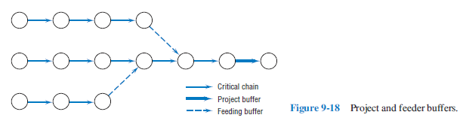
The Critical Chain (Slide 2 of 3)
8-<number>

Slide 39
The Critical Chain (Slide 3 of 3)
Delays on projects due to
  delay of one or more activities in the critical chain
  delay in one or more of the activities on a noncritical or “feeder” chain
8-<number>

Slide 40
Copyright
Copyright © 2018 John Wiley & Sons, Inc.
All rights reserved. Reproduction or translation of this work beyond that permitted in Section 117 of the 1976 United States Act without the express written permission of the copyright owner is unlawful. Request for further information should be addressed to the Permissions Department, John Wiley & Sons, Inc. The purchaser may make back-up copies for his/her own use only and not for distribution or resale. The Publisher assumes no responsibility for errors, omissions, or damages, caused by the use of these programs or from the use of the information contained herein.
Copyright ©2018 John Wiley & Son, Inc.

